Slide 1
Service Marketing
GSRTC Service
Made by :
Nisarg Godhani 22bce096

Slide 2
Gujarat State Road Transport Corporation (GSRTC) – An Overview
GSRTC is a government-owned public transportation service connecting
urban and rural areas across Gujarat and neighboring states.
Key Sectors: Passenger transport, intercity bus services, and state-wide connectivity.
Industry Data:
GSRTC operates 8,322 buses, serving 25 lakh (2.5 million) passengers daily.
Competes with private bus operators and Indian Railways
for intercity and interstate travel.
Provides AC/Non-AC buses, sleeper coaches, and
express services to cater to different passenger needs.
Faces challenges related to service reliability,
customer satisfaction, and fleet modernization.

Slide 3
Industry and Competitor Analysis
Breakdown of Industry Data: GSRTC serves 25 lakh (2.5 million)
passengers daily with a fleet of 8,322 buses across 125 depots.
Provides connectivity between urban,
semi-urban, and rural areas, playing a crucial role in
Gujarat’s public transport ecosystem.
Market Share & Competitor Analysis:
GSRTC vs Private Operators: GSRTC competes
with private bus services offering luxury coaches and flexible schedules.
GSRTC vs Indian Railways: Trains serve as a major competitor for long-distance travel, offering affordability and comfort.
Strengths: Affordable fares, wide connectivity, government-backed reliability.
Weaknesses: Aging fleet, delays, inconsistent service quality compared to premium private operators.

Slide 4
Objectives and SPSS Analysis Overview
Objectives of the Analysis:
Evaluate customer satisfaction using the SERVQUAL model (Tangibles, Reliability, Responsiveness, Assurance, Empathy).
Identify gaps between passenger expectations and service quality.
Provide recommendations for service improvement based on data insights.
Purpose of Using SPSS for Statistical Analysis:
SPSS was used to analyze survey responses from 217 participants, helping to quantify perceptions of GSRTC’s service quality.
Enables detailed statistical tests to identify significant trends in customer satisfaction.

Slide 5
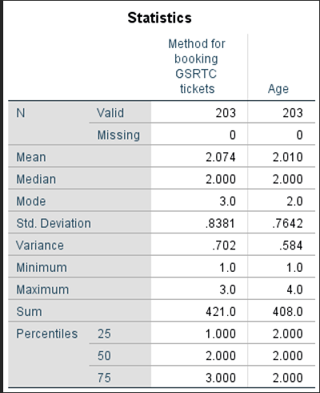
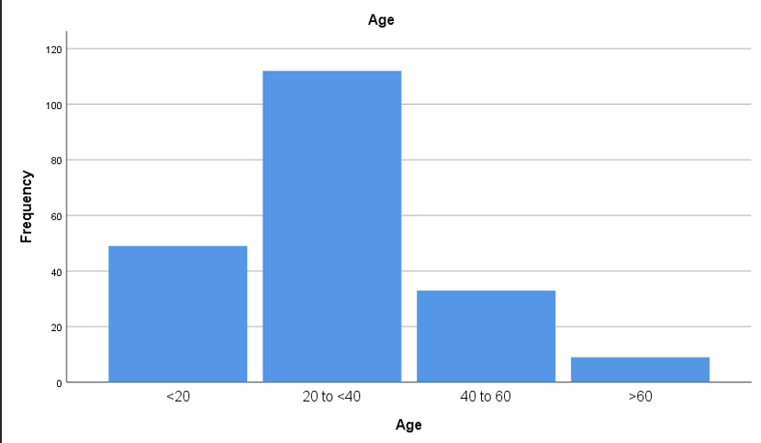
The survey results indicate that the most common method for booking GSRTC tickets is via mobile app (38.9%), followed by online website (31.5%) and ticket counter (29.6%). The median age of respondents is 2.000, suggesting a relatively young demographic, with 75% of respondents falling within the age category represented by the value 2.000.

Slide 6
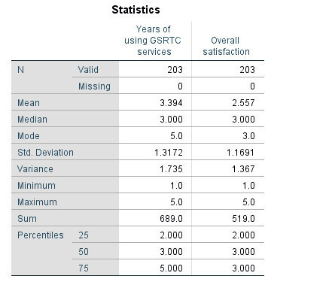
The survey results show that 29.6% of respondents have been using GSRTC services for more than 4 years, with a median usage duration of 3 years. The overall satisfaction level has a median of 3.000, indicating moderate satisfaction, and 75% of respondents report a satisfaction level of up to 3.000. The data suggests a relatively stable user base with varied satisfaction levels.

Slide 7
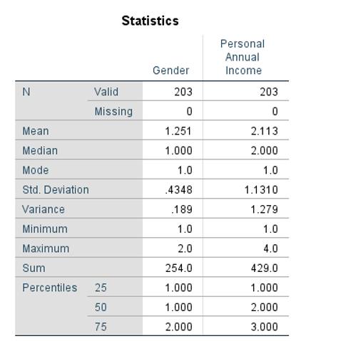
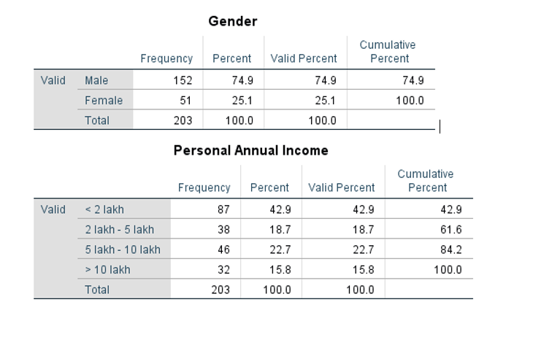
Frequency Analysis
We have done Frequency Analysis on the basis of Gender
And Personal Income

Slide 8
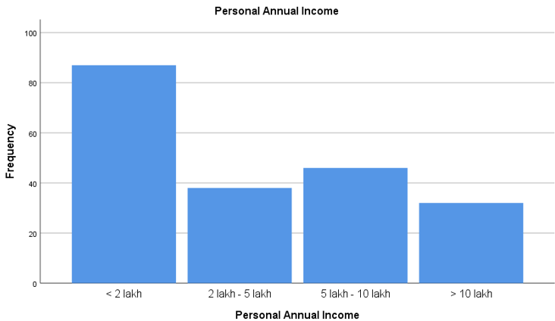
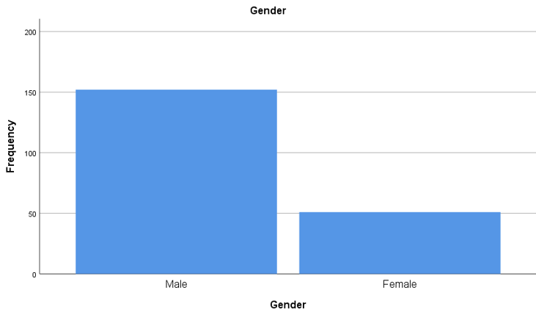
Frequency Analysis Graph
The survey results provide significant insights into the demographic and income distribution of respondents.
1. Gender Distribution: The majority of respondents are male (74.9%), with females comprising 25.1%. This indicates a gender imbalance in the sample, which may influence the interpretation of results and the design of targeted interventions.
2. income Distribution : The personal annual income data shows that 42.9% of respondents earn less than 2 lakh, while 22.7% earn between 5 lakh and 10 lakh, and 15.8% earn more than 10 lakh. The median income is 2 lakh, with a mean of 2.113, indicating a right-skewed distribution. The standard deviation of 1.1310 highlights variability in income levels.

Slide 9
Hypothesis Formulation 1. Null Hypothesis (H₀): There is no association between frequency of marital status and sharing type. 2. Alternative Hypothesis (H₁): There is an association between frequency of marital status and sharing type.
Chi-Square Test

Slide 10
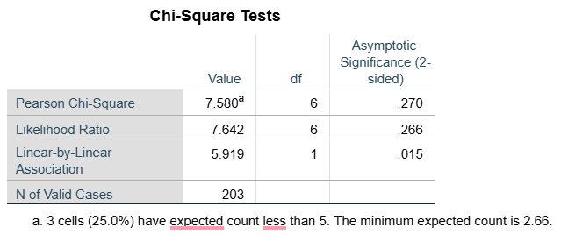
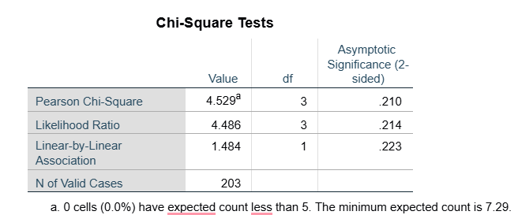
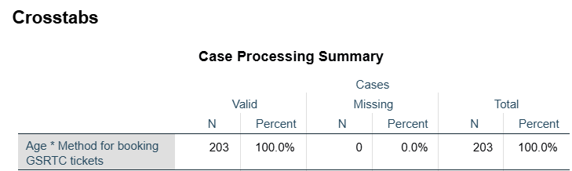
Chi-Square Test & Cross Tabulation
Objective:
To examine the association between different demographic factors and service preferences using the Chi-Square test.
To determine whether variables like gender, age, income, and travel class preference are statistically related.
To analyze cross-tabulation results and derive meaningful insights into customer behavior.

Slide 11
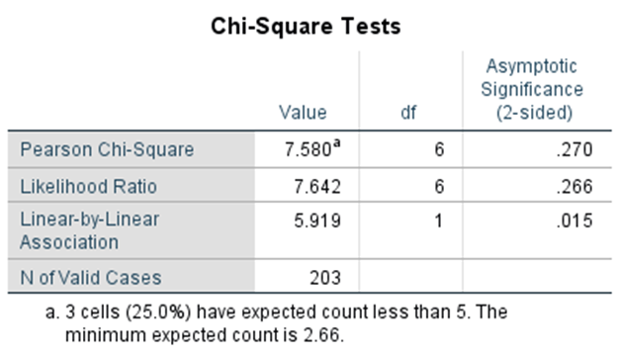
Chi-Square Test
Result analysis :
The crosstabulation shows that younger age groups (<20 and 20 to <40) prefer the mobile app (49.0% and 42.2%, respectively), while older age groups (40 to 60 and >60) prefer the online website (45.5% and 44.4%, respectively). The Pearson Chi-Square (p=0.270) and Likelihood Ratio (p=0.266) tests indicate no significant overall association between age and booking method. However, the Linear-by-Linear Association (p=0.015) suggests a significant linear trend, with older individuals favoring online and ticket counter bookings more than younger individuals.

Slide 12
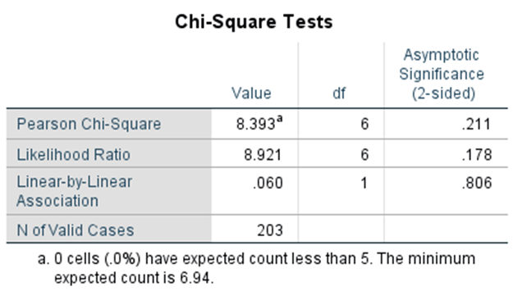
Chi-Square Test
The crosstabulation shows that individuals across all income groups most frequently use GSRTC services "a few times per month," with the percentage (43.7%) in the <2 lakh income group. The chi-square tests (Pearson Chi-Square p=0.211, Likelihood Ratio p=0.178, Linear-by-Linear Association p=0.806) indicate no significant association or linear relationship between personal annual income and the frequency of using GSRTC services. The observed differences in usage frequency are likely due to random variation rather than income level.

Slide 13
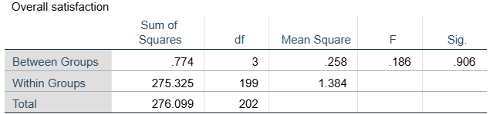
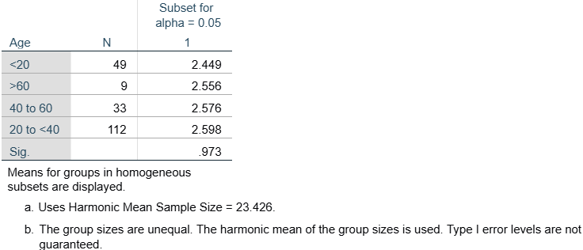
ANOVA (Analysis of Variance)
Objective:
To determine whether there are statistically significant differences in overall satisfaction across various groups (e.g., age, income, occupation, travel class).
To use F-statistics and p-values to assess variations in service perception among different passenger segments.
To interpret the results and identify key factors influencing satisfaction levels within GSRTC services.

Slide 14
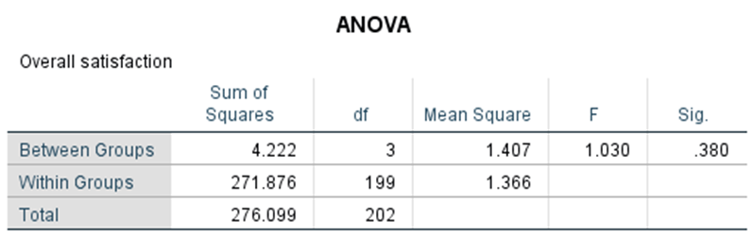
ANOVA (Analysis of Variance)
Combined Conclusion:
The ANOVA results indicate that the income groups do not differ significantly in terms of overall satisfaction.
Final Interpretation: The null hypothesis is not rejected, suggesting that any differences in satisfaction levels among the income groups are not statistically significant.

Slide 15
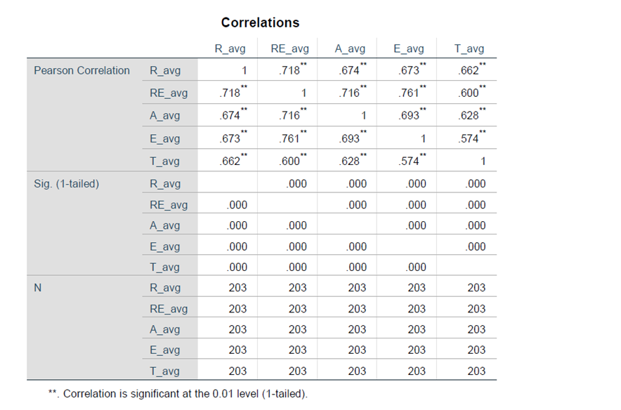

Slide 16
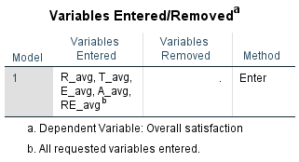
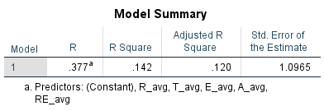
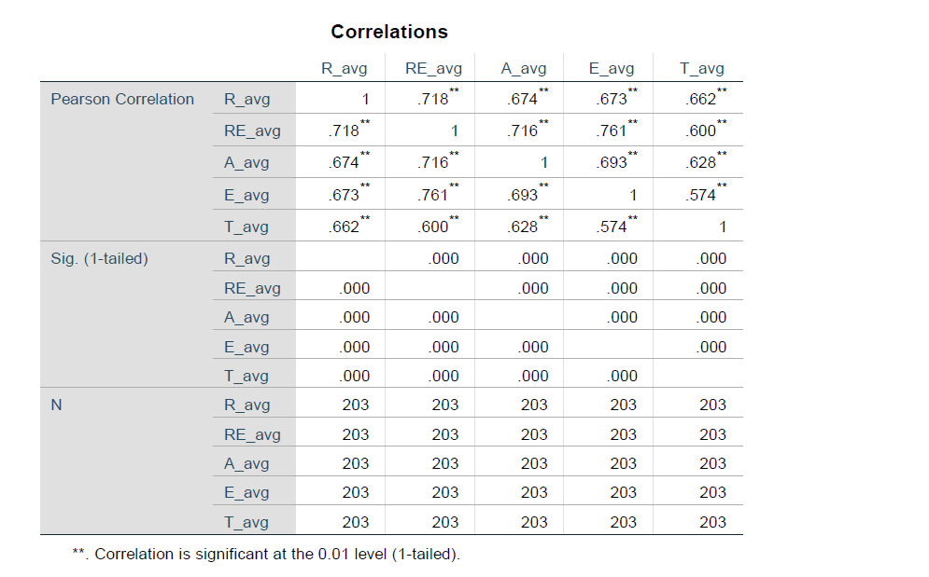
Regression
Final Findings and Results:
The regression model, including Reliability, Tangibles, Empathy, Assurance, and Responsiveness, significantly predicts Overall Satisfaction (p < 0.001) but explains only 14.2% (R² = 0.142) of its variance. Among the factors, Reliability and Responsiveness show the strongest correlation with Satisfaction. The ANOVA test confirms the model's statistical significance (F = 6.532, p < 0.001), meaning at least one variable significantly affects satisfaction. The correlation matrix reveals that Empathy (0.761), Reliability (0.718), and Assurance (0.674) are the most influential service dimensions. These findings suggest that enhancing Reliability and Responsiveness will have the most significant impact on improving customer satisfaction at GSRTC.

Slide 17
Perception vs Expectation Analysis
Analysis of Customer Perception vs Expectation
The study evaluated the service quality of Gujarat State Road Transport Corporation (GSRTC) using the SERVQUAL model, which measures gaps between customer expectations and perceptions. The analysis focused on five dimensions: Reliability, Responsiveness, Assurance, Empathy, and Tangibles.

Slide 18
Key Findings
Reliability (3.32/5) – Customers find GSRTC moderately reliable, but delays, schedule inconsistencies, and poor communication affect trust.
Responsiveness (3.27/5) – While staff provides occasional prompt service, improvements are needed in handling customer concerns efficiently.
Assurance (3.35/5) – Passengers generally feel safe, though inconsistent staff behavior affects confidence.
Empathy (3.34/5) – Customers report moderate satisfaction with personalized service, but better understanding of passenger needs is required.
Tangibles (3.30/5) – Infrastructure and cleanliness are average, with customers expecting modernization and better maintenance.

Slide 19
Gap Analysis (Expectation vs Perception)
A significant gap exists between what customers expect and what they perceive, primarily in reliability and responsiveness.
Expectation: Timely, well-maintained, and customer-friendly service.
Perception: Moderate service quality with gaps in punctuality, staff behavior, and cleanliness.

Slide 20
Key Insights
Reliability and Responsiveness need urgent improvements, especially in real-time tracking and customer support.
Modernization of buses and station facilities can enhance passenger experience and reduce the perception gap.
Staff training programs focusing on customer interaction and service consistency can improve Assurance and Empathy ratings.
By addressing these gaps, GSRTC can significantly enhance passenger satisfaction and service efficiency.

Slide 21
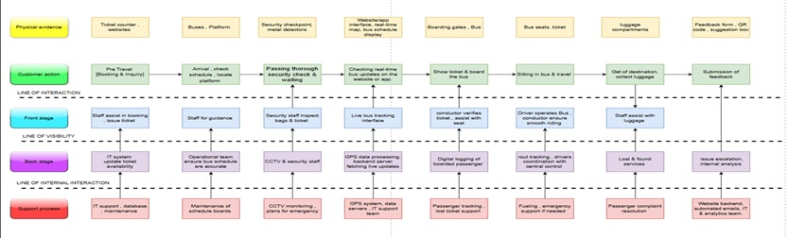
SERVICE BLUEPRINT

Slide 22
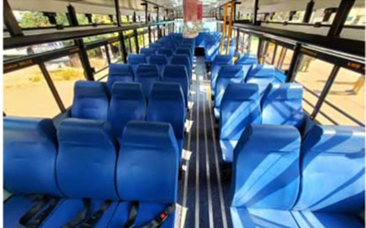
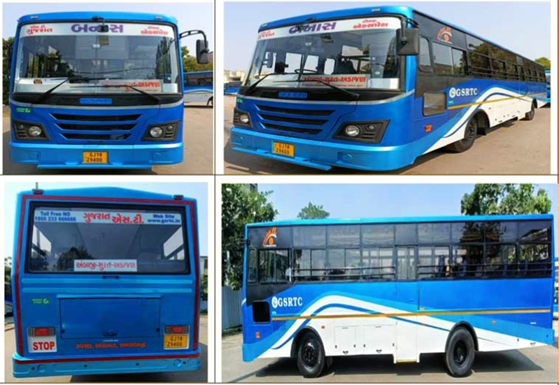
Physical Evidence

Slide 23
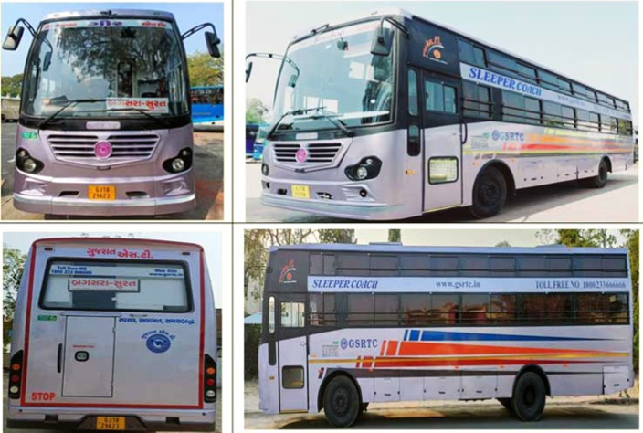
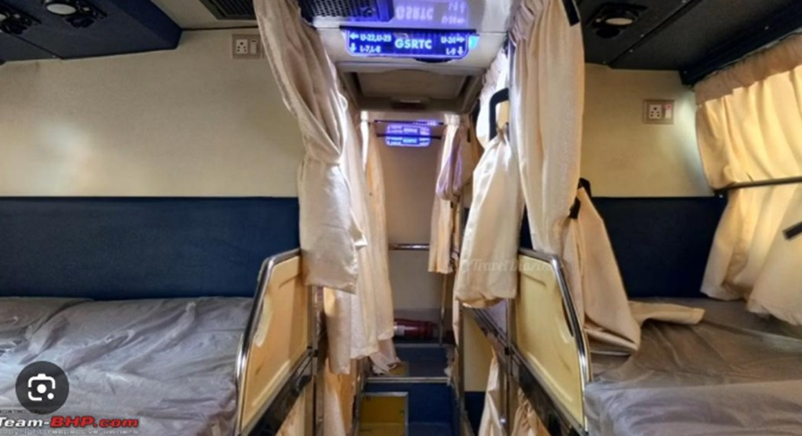
Physical Evidence

Slide 24
Conclusion
The GSRTC analysis using the SERVQUAL model highlights reliability as the key factor affecting passenger satisfaction, with delays and scheduling issues being major concerns. Responsiveness, assurance, tangibles, and empathy also influence service perception. Key improvements include real-time tracking, better-trained staff, enhanced safety, fleet modernization, and digital adoption. Addressing these gaps will boost satisfaction, increase ridership, and strengthen GSRTC’s competitiveness against private operators.

